Slide 1
Machine Learning
Quiz 3

Slide 2
Question 1 (2.5 Points)
True or False
Decision stumps are depth 1 decision trees.
Decision stumps are always linear classifiers.
k-means always converges to a local optimum.
Initializing centroids using k-means++ guarantees convergence to a global optimum. (Justify your choice)
Notes:
True (0.5)
True (0.5)
True (0.5)
No. (k-means++ improves cluster initialization that may improve the cluster quality but does not guarantee global convergence) (1.0)
Deduct 0.5 points if the justification is missing or is not valid.

Slide 3
Question 2 (3 Points)
True or False
Ensemble models have better interpretability. (Justify your choice)
Base learners for an ensemble model can come from the same algorithm with different hyper-parameters.
Ensemble model is always better than any of its individual models.
Generally, an ensemble method works better, if the individual base models have high correlation among predictions. (Justify your choice)
Notes:
False (because ensemble models – which are build by combining multiple base models – typically give us better performance but have higher complexity (lower interpretability) (1.0)
True (0.5)
False (0.5)
False (If base models have high correlations among their predictions then this decreases the error-correcting capability of the ensemble model) (1.0)
Deduct 0.5 points (in both questions) if the justification is missing or is not valid.

Slide 4
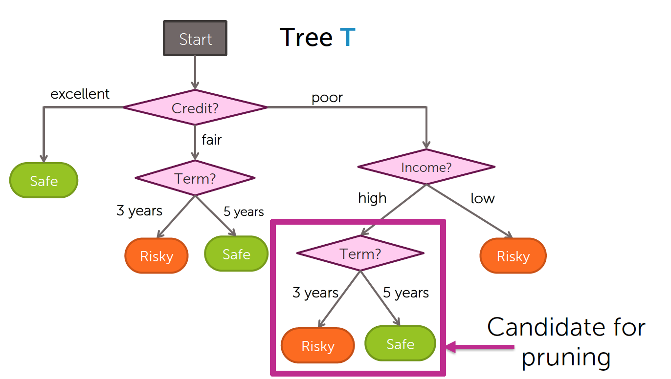

Question 3 (2 Points)
Let the classification error of T (shown below) be 0.25 and let $λ=0.3.$ The candidate for pruning is shown separately. If the classification error after pruning is 0.26. Will we prune or not? Justify your choice.
Notes:
CE = 0.25
Lamda = 0.3
C(T) = CE + lamda (# of leaves) = 0.25 + 0.3 (6) = 0.43
C(T_smaller) = 0.26 + 0.3 (5) = 0.41
C(T_smaller) < C(T); therefore, we will prune
Deduct 1.5 points if the justification is missing or is not valid.
Deduct 0.5 points if the justification is valid but is in simple words without any calculations to support it.

Slide 5
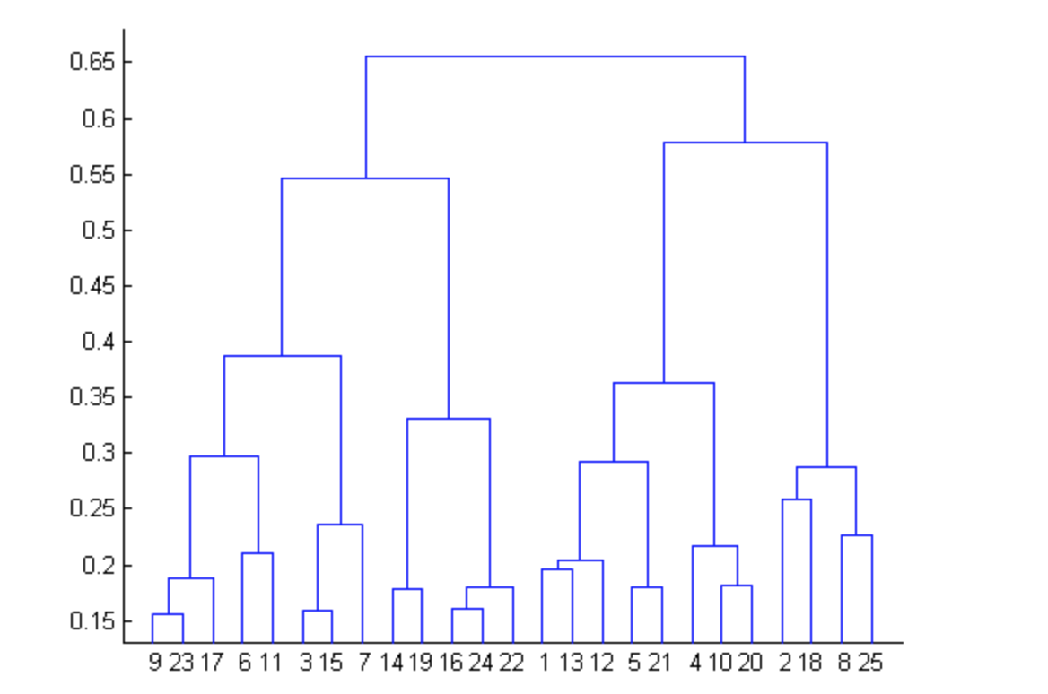
Question 4 (1 Point)
After performing K-Means Clustering analysis on a dataset, you observed the following dendrogram. Which of the following conclusion can be drawn from the dendrogram? Why?
There were 28 data points in clustering analysis
The best no. of clusters for the analyzed data points is 2
The proximity function used is Average-link clustering
The above dendrogram interpretation is not possible for K-Means clustering analysis
Notes:
D) Because a dendrogram is not possible for K-Means clustering analysis
Deduct 0.5 points if the justification is missing or is not valid.

Slide 6
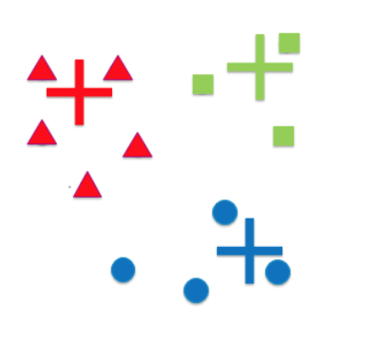
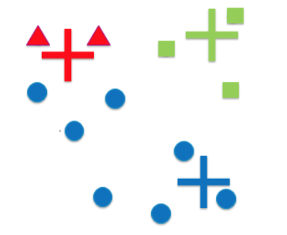
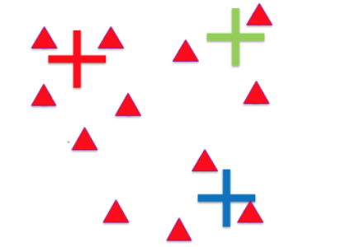
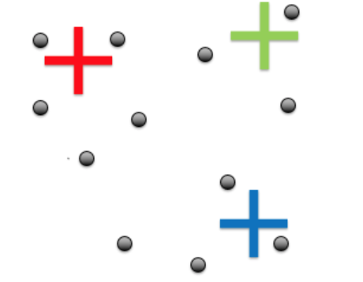
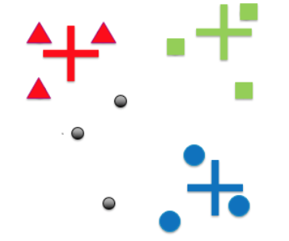
Question 5 (4 Points)
Suppose we initialize k-means with the following centroids
a
b
c
For each of the above tell whether or not (Yes or No) it best describes the cluster assignment in the first iteration of k-means. Why?
d
Notes:
a) Yes (overall clustering follows the assignment based on the shortest distances from the cluster centers)
b) No (blue cluster is longer/elongated than it should be)
c) No (all points are assigned to the same cluster, which is not possible)
d) No (three points are not assigned to any cluster, which is not possible at the end of an iteration)
Deduct 0.5 points (in all cases) if the justification is missing or is not valid.

